Slide 1
EDUBE – A VISUAL SOCIAL BOOKMARKING
Shri Shankaracharya Institute of Professional Management & Technology, Raipur
Minor Project Report on
CSE 7th Semester
Department of Computer Science and Engineering,
Batch 2018-2022
Session July – Dec 2021
Presentation Date: 01/02/2022
Project Guide:
Mrs. Sumitra Samal
Assistant Professor, CSE Dept
Project Group Members:
Bhumika Pankaj Bhandari (303302218003)
Amrit Matharu (303302218009)
Shrishti Chourasiya (303302218012)

Slide 2
INDEX
Introduction
Application Area
Project Overview
Project Requirements (Developer )
Project Requirements (End User )
Back End Details
Database Details
Front End Details
Project Flow Diagram
Data Flow Diagram
Result & Conclusion
References

Slide 3
Introduction
Edube is a free social networking application. It allows users to register and to create a professional profile which will be visible to others. Edube can also be used to organize offline events, write articles, publish job postings, post photos and more.
The Edube is a software designed for this specific purpose to provide an education-based online service that operates via mobile app. Edube focuses on creating an institute-based network for providing all the necessary information regarding jobs, offline events, training, and more.

Slide 4
Application Area
Edube is focused on providing a single platform for all the institute-based job related posts. Employers can list jobs and search for potential candidates while Users can save jobs that they would like to apply for. Through this app, you can also see at a glance what your connections are working on and get technology related knowledge from them and apart from it are the below mentioned benefits : -
Updates on job post in a single platform
It’s easy to share skills and achievements
A single platform to share technology related contents and recruitment for job seekers, as well as expanding their network among people.

Slide 5
Project Overview
It is a social network that allows users to register and to create a professional profile which will be visible to others. Through the site, individuals can maintain a list of known people, known as Connections. Members can invite anyone (whether an existing member or not) to become a connection.
The basic functionality of Edube allows users to create profiles, which for employees typically consist of a curriculum vitae describing their work experience, education and training, skills, and a personal photo.
Edube also serves as an effective medium by which both employers and job seekers can review listed professional information about one another.

Slide 6
Project Requirements (Developer)
SOFTWARE REQUIREMENT (With Versions duly mentioned)
Front-end – HTML5, CSS3, JavaScript, React JS, NPM
Software – Visual Studio Code, Node
Back-end – Node.js (14.18.0),Express.js (4x),MongoDB(Database, 5.0)
Operating System – Windows 7 or above
HARDWARE REQUIREMENT
Intel Core i3 processor or above
The disk requirement is 150GB
It requires a 4 GB RAM or above
Internet Connection
Display – Any Compatible Monitor
Keyboard

Slide 7
Project Requirements (End User)
SOFTWARE REQUIREMENT (With Versions duly mentioned)
Android 7 or above
HARDWARE REQUIREMENT
Minimum 2 GB RAM
Minimum HDD free space – 250Mb
Connection – Internet Connection

Slide 8
Back End Details
What Back End your project is using?
Node.js (14.18.0), Express.js (4x), MongoDB(Database, 5.0)
How Many Databases?
Only One
How Many Tables?
6 Tables (Collections)

Slide 9
Database Details
Database Name -
edube_db
Tables Name -
1. users
2. userDemos
3. pictures
4. chatPictures
5. messages
6. messageItems

Slide 10
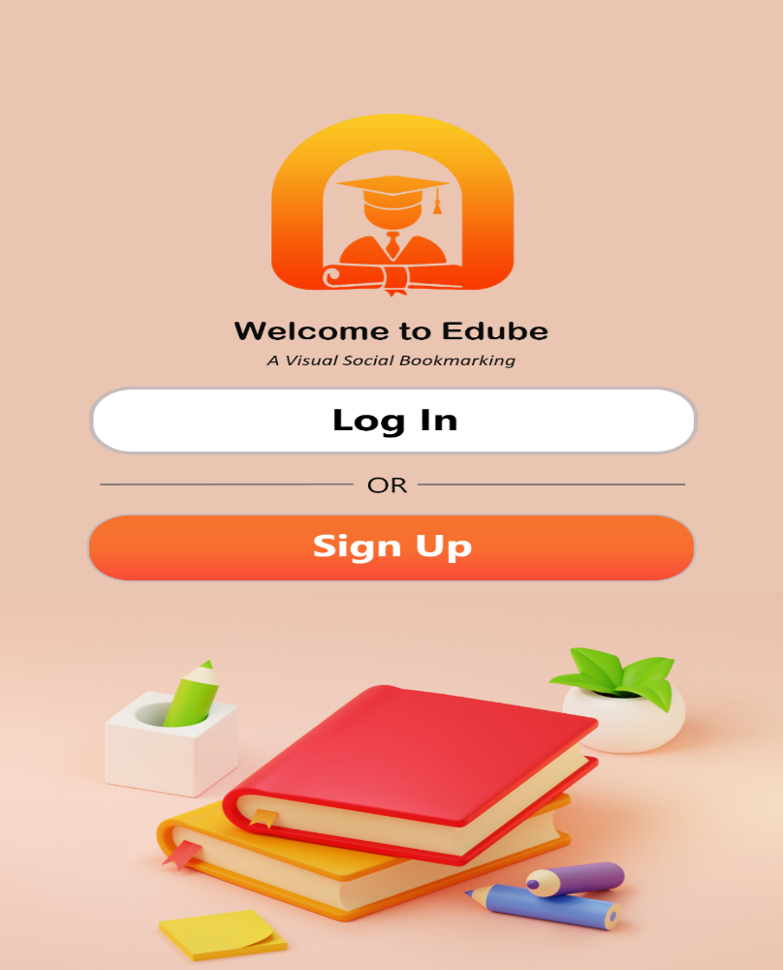
Front End Details
Our application will have around 5 screens and it will look like below images.
Few Interfaces of the Application
Interface of Welcome Screen

Slide 11
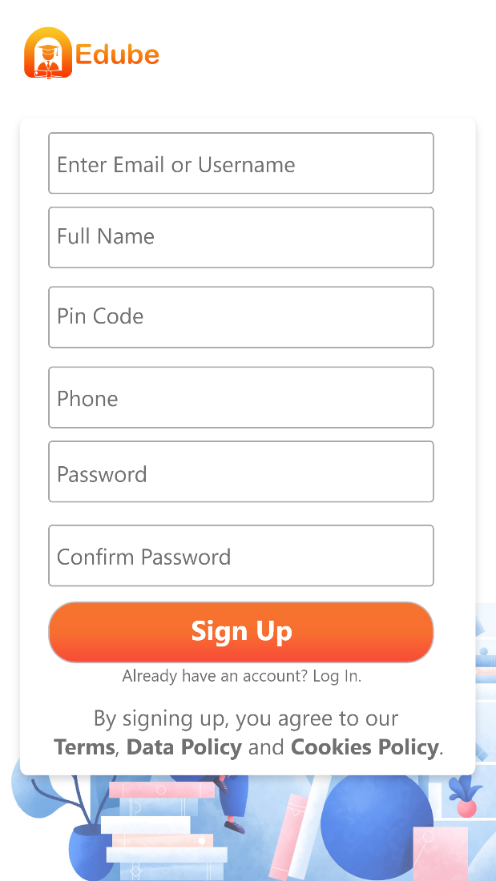
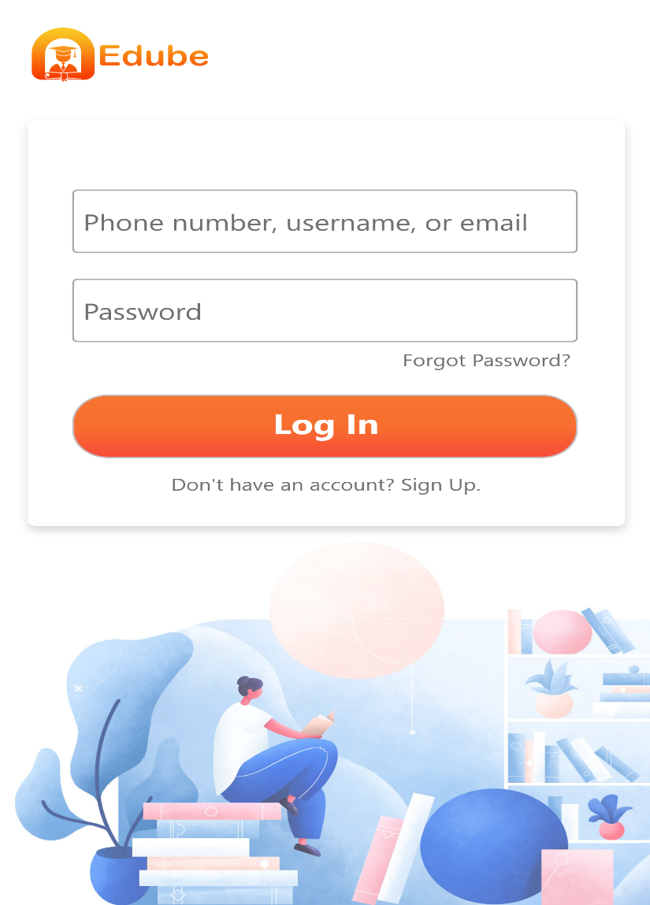
Interface of Register Screen
Interface of Login Screen

Slide 12
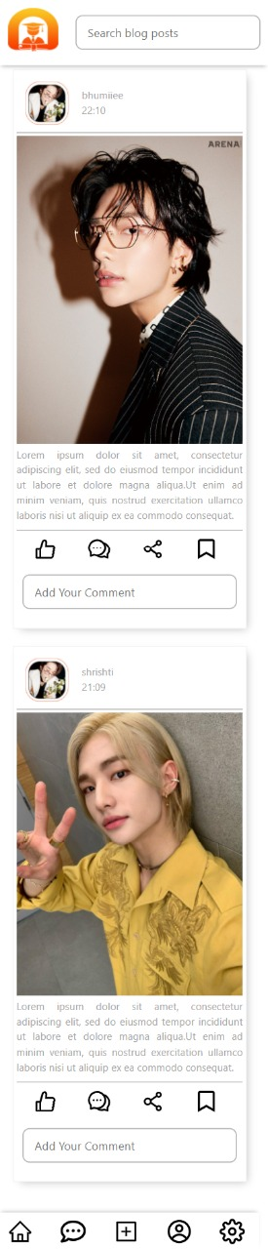
Interface of User Dashboard Screen

Slide 13
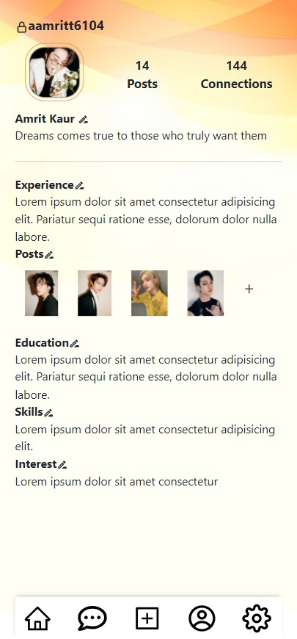
Interface of User Profile Screen

Slide 14
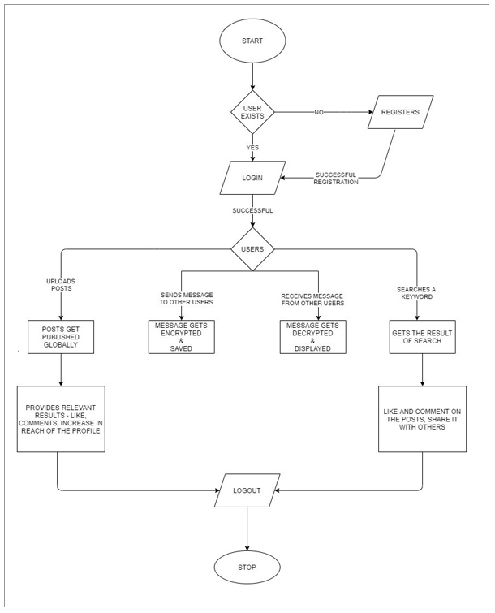
WORKFLOW DIAGRAM

Slide 15
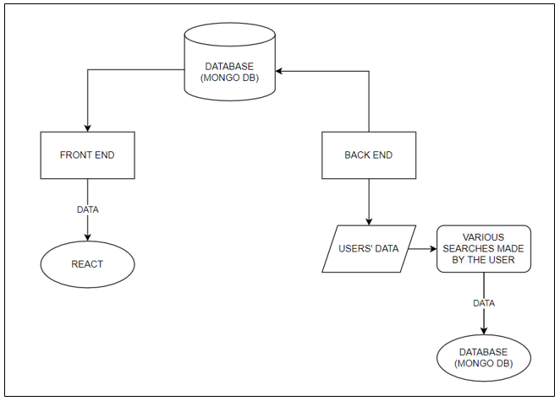
FLOW CHART OF WEB APP PROCESSING

Slide 16
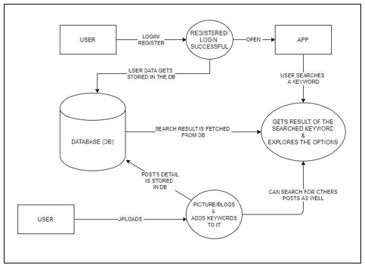
DATA FLOW DIAGRAM

Slide 17
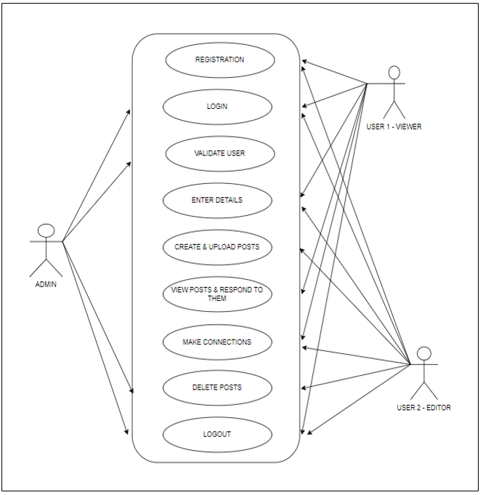
USE CASE DIAGRAM

Slide 18
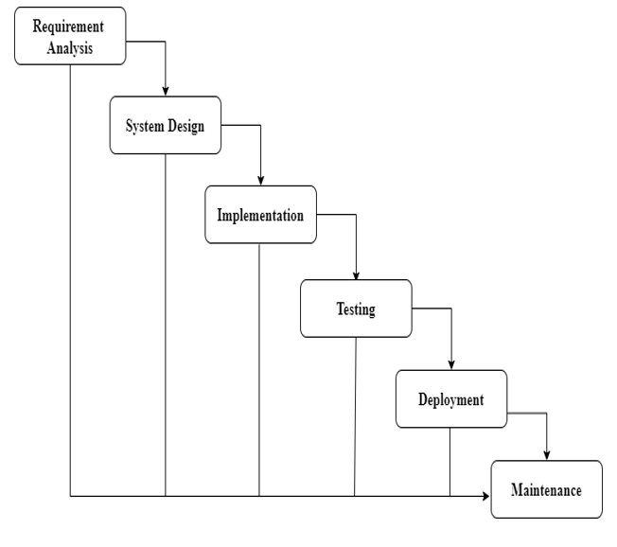
WATERFALL MODEL OF SDLC

Slide 19
Result & Conclusion
With the help of this application, users can keep profiles up-to-date which allows one’s connections to be informed on their recent awards or recognitions within the community.
Edube’ s user profile is like a digital resume, which tells members of Edube of your skills and capabilities.
Edube can help you build a virtual network of contacts. This could prove valuable if you are looking for a job at some point in your career.

Slide 20
References
Web Resources
http://www.stackoverflow.com
https://developer.android.com/guide
https://medium.com/
https://www.javatpoint.com/
https://developer.mozilla.org/en-US/
https://en.wikipedia.org/
https://www.geeksforgeeks.org/
https://reactjs.org/
https://react-bootstrap.github.io/
THANK YOU !!

